Slide 1
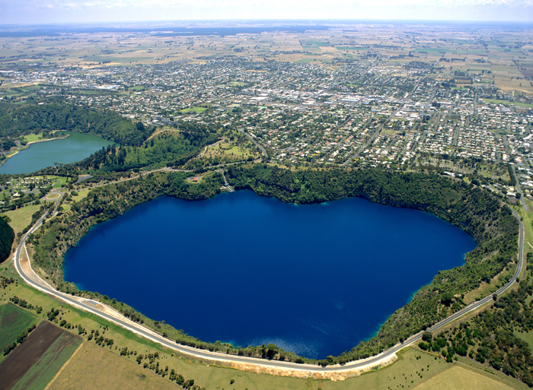
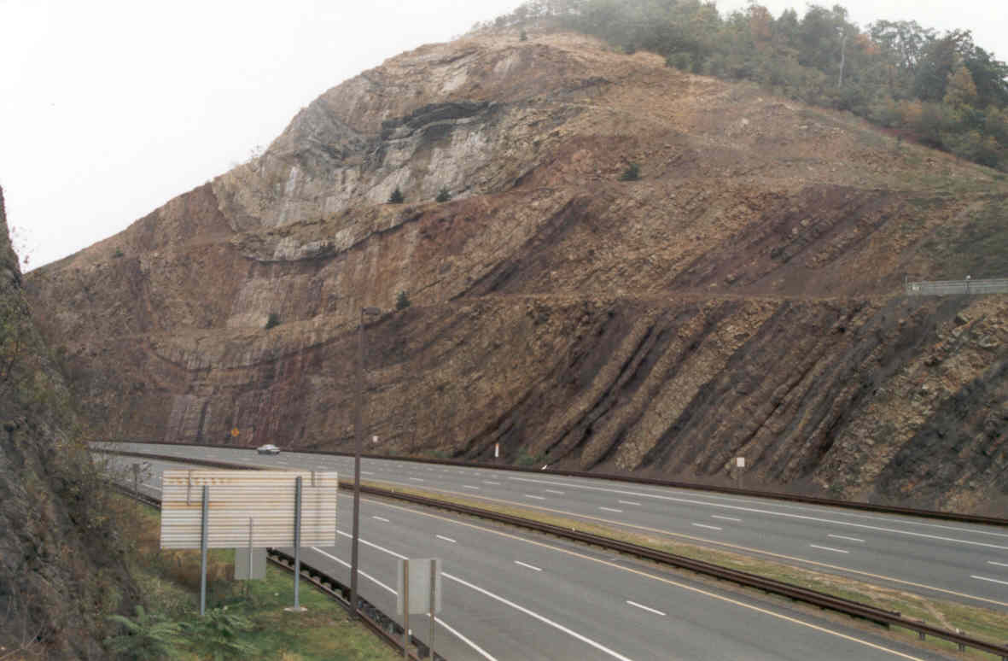
Geological Structures

Slide 2
Definition of structural geology
interested in studying earth secondary structures resulting from exposure lithosphere rocks to the process of deformation due to tectonic forces and non-tectonic.

Slide 3
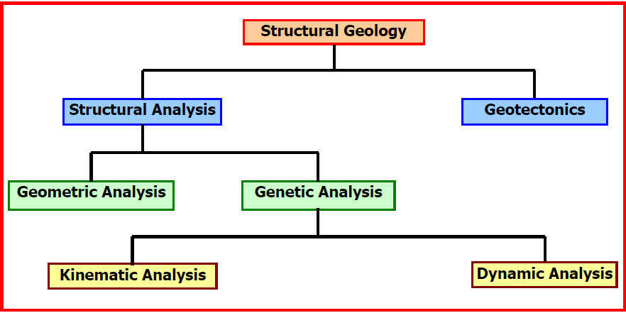

Slide 4
Geotectonic
1. Contraction theory.
2. Geosynclines theory.
3. Continental drift theory.
4. Thermal convection currents.
5. Sea floor spreading.
6. Plate tectonics theory.

Slide 5
Geological Structures
Geological structures are geometric patterns of rocks can determine the dimensions and forms and distribution. Depending on the reasons for their formed is divided into two basic types

Slide 6
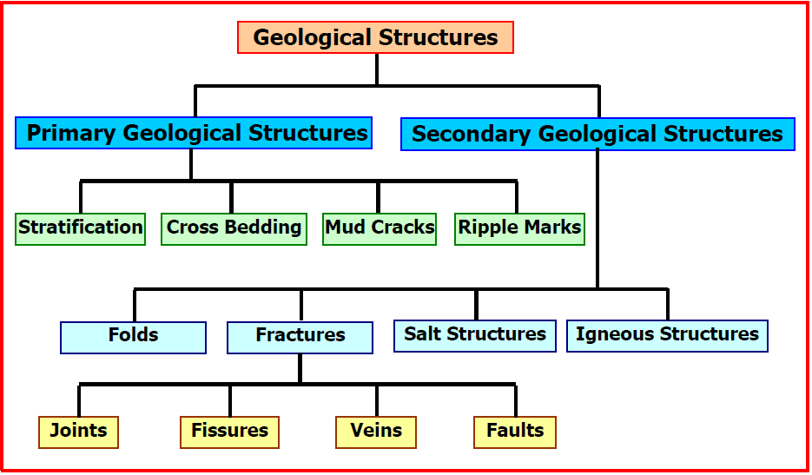

Slide 7
Importance of structural geology:
1. Engineering Geology: the establish of engineering structures take study the structure of the foundation rock of great importance especially when the construction of dams and tunnels, where you must
take fractures and trends into account.

Slide 8
2. Petroleum Geology: many oil traps represent structural manifestations (folds or faults).
3. Economic Geology: The evaluation of economic importance to the ore or the rocky body such as coal or limestone is by selecting structural dimensions and place it.
4. Hydrogeology: Linking water reservoirs existence of geological structures fractures and folds.

